Slide 1
DIGITAL LOGIC
N.JAFRIN
ASSISTANT PROFESSOR
DEPARTMENT OF COMPUTER SCIENCE & IT
JAMAL MOHAMED COLLEGE(AUTONOMOUS)
TRICHY

Slide 2
iNTRODUCTION
NUMBER SYSTEM
A digital system can understand positional number system only where there are a few symbols called digits and these symbols represent different values depending on the position they occupy in the number.
A value of each digit in a number can be determined using
The digit
The position of the digit in the number
The base of the number system (where base is defined as the total number of digits available in the number system).

Slide 3
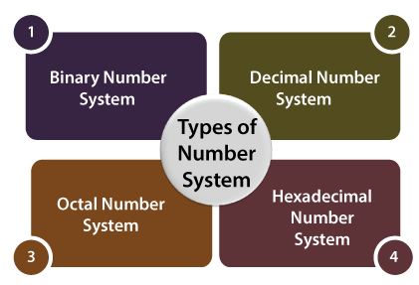
Types of Number System
In the digital computer, there are various types of number systems used for representing information

Slide 4
Types of Number System
S.N Number System & Description
1 Binary Number System
Base 2. Digits used: 0, 1
2 Octal Number System
Base 8. Digits used: 0to 7
3 Hexa Decimal Number System
Base 16. Digits used: 0 to 9, Letters used: A- F
4 Decimal Number system base: 10, Digits used: 0 to 9.

Slide 5
Binary Number System
Characteristics
Uses two digits, 0 and 1.
Also called base 2 number system
Each position in a binary number represents power of the base (2). Example: 2⁰
Examples:
(10100)₂, (11011)₂, (11001)₂, (000101)₂, (011010)₂.

Slide 6
Binary Number System
Example
Binary Number : 10101₂
Calculating Decimal Equivalent −
Step Binary NumberDecimal Number
Step 1 :
10101₂((1 × 2⁴) + (0 × 2³) + (1 × 2²) + (0 × 2¹) + (1 × 2⁰))₁₀
Step 2: 10101₂(16 + 0 + 4 + 0 + 1)₁₀
Step 3: 10101₂ - 21₁₀
Note: 10101₂ is normally written as 10101.

Slide 7
Decimal Number System
The decimal numbers are used in our day to day life. The decimal number system contains ten digits from 0 to 9(base 10).
Here, the successive place value or position, left to the decimal point holds units, tens, hundreds, thousands, and so on.
The 0 is the minimum value of the digit, and 9 is the maximum value of the digit.

Slide 8
Decimal Number System
For example:
The decimal number 2541 consist of the digit 1 in the unit position, 4 in the tens position, 5 in the hundreds position, and 2 in the thousand positions and the value will be written as:
= (2×1000) + (5×100) + (4×10) + (1×1) (2×10³) + (5×10²) + (4×10¹) + (1×10⁰)
= 2000 + 500 + 40 + 1
=2541

Slide 9
Octal Number System
Characteristics
Uses eight digits, 0,1,2,3,4,5,6,7.
Also called base 8 number system
Each position in an octal number represents a 0 power of the base (8). Example: 8⁰

Slide 10
Octal Number System
Example
Octal Number − 12570₈
Calculating Decimal Equivalent −
Step Octal Number Decimal Number
Step 1:
12570₈ = ((1 × 8⁴) + (2 × 8³) + (5 × 8²) + (7 × 8¹) +
(0 × 8⁰))₁₀
Step 2:
12570₈ = (4096 + 1024 + 320 + 56 + 0)₁₀
Step 3: 12570₈ = 5496₁₀

Slide 11
Hexadecimal Number System
Characteristics
Uses 10 digits and 6 letters, 0,1,2,3,4,5,6,7,8,9,A,B,C,D,E,F.
Letters represents numbers starting from 10. A = 10, B = 11, C = 12, D = 13, E = 14, F = 15.
Also called base 16 number system.
Each position in a hexadecimal number represents a 0 power of the base (16). Example: 16⁰.

Slide 12
Hexadecimal Number System
Hexadecimal Number: 19FDE₁₆
Calculating Decimal Equivalent −
Step Hexadecimal Number Decimal Number
Step 1:
19FDE₁₆ = ((1 × 16⁴) + (9 × 16³) + (F × 16²) + (D × 16¹) +
(E × 16⁰))₁₀
Step 2:
19FDE₁₆ = ((1 × 16⁴) + (9 × 16³) + (15 × 16²) + (13 × 16¹) +
(14 × 16⁰))₁₀
Step 3: 19FDE₁₆ = (65536 + 36864 + 3840 + 208 + 14)₁₀
Step 4 : 19FDE₁₆ = 106462₁₀

Slide 13
Number Base Conversion
In our previous section, we learned different types of number systems such as binary, decimal, octal, and hexadecimal. In this part we will learn how we can change a number from one number system to another number system.
four types of number systems so each one can be converted into the remaining three systems. There are the following conversions possible in Number System
Binary to other Number Systems.
Decimal to other Number Systems.
Octal to other Number Systems.
Hexadecimal to other Number Systems.

Slide 14
Number Base Conversion

Slide 15
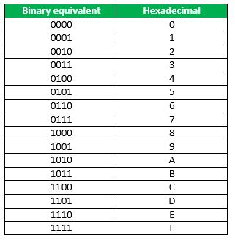
Number Base Conversion

Slide 16
Decimal Number to other Bases Conversion
1. Decimal to Binary :
The following two types of operations take place, while converting decimal number into its equivalent binary number.
Division of integer part and successive quotients with base 2.
Multiplication of fractional part and successive fractions with base 2.
Example
(10.25)₁₀

Slide 17
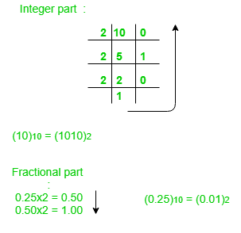
Decimal to Binary
Answer: (10.25)₁₀ = (1010.01)₂

Slide 18
Decimal to Octal
The following two types of operations take place, while converting decimal number into its equivalent octal number.
Division of integer part and successive quotients with base 8.
Multiplication of fractional part and successive fractions with base 8.
Example
(58.25)₁₀
(58)₁₀ = (72)₈
Fractional part:
0.25 x 8 = 2.00 the octal equivalent of decimal number 58.25 is 72.2.

Slide 19
Decimal to Hexa-Decimal Conversion
The following two types of operations take place, while converting decimal number into its equivalent hexa-decimal number.
Division of integer part and successive quotients with base 16.
Multiplication of fractional part and successive fractions with base 16.
Example
Consider the decimal number 58.25.
Here, the integer part is 58 and decimal part is 0.25.

Slide 20
Decimal to Hexa-Decimal Conversion
Step 1 − Division of 58 and successive quotients with base 16.
Operation Quotient Remainder
58/16 3 10=A
3/16 0 3
58₁₀ = 3A₁₆
Step 2 − Multiplication of 0.25 and successive fractions with base 16.
Operation Result Carry
0.25 x 16 4.00 4
- 0.00 -
.25₁₀ = .4₁₆

Slide 21
Binary numer system to other number system
Shortcut method - Binary to Octal
Steps
Step 1 − Divide the binary digits into groups of three (starting from the right).
Step 2 − Convert each group of three binary digits to one octal digit.
Example
Binary Number − 10101₂

Slide 22
Binary to Octal
Shortcut method - Binary to Octal
Steps
Step 1 − Divide the binary digits into groups of three (starting from the right).
Step 2 − Convert each group of three binary digits to one octal digit.
Example
Binary Number − 10101₂

Slide 23
Binary to Octal
Step | Binary Number | Octal Number
Step 1 | 10101₂ | 010 101
Step 2 | 10101₂ | 2₈ 5₈
Step 3 | 10101₂ | 25₈
Binary Number − 10101₂ = Octal Number − 25₈

Slide 24
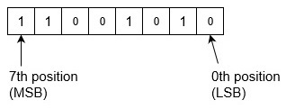
Binary to Decimal number system
Positional Notation
Most Significant Bit (MSB) | Binary Point |  | Least Significant Bit (LSB)
2² | 2¹ | 2⁰ | 2⁻¹ | 2⁻² | 2⁻³
4 | 2 | 1 | 0.5 | 0.25 | 0.125
Example-1 − Convert binary number 11001010 into decimal number

Slide 25
Binary to Decimal number system
Example-1 − Convert binary number 11001010 into decimal number
= (11001010)₂
=1x2⁷+1x2⁶+0x2⁵+0x2⁴+1x2³+0x2²+1x2¹+0x2⁰
= 128+64+0+0+8+0+2+0
= (202)₁₀

Slide 26
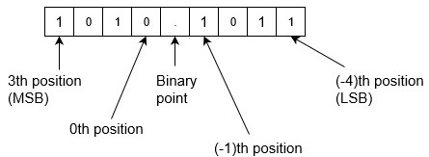
Binary to Decimal number system
Example-2 − Convert binary number 1010.1011 into decimal number.
Binary to decimal is,
= (1010.1011)₂
= 1x2³+0x2²+1x2¹+0x2⁰+1x2⁻¹+0x2⁻²+1x2⁻³+1x2⁻⁴
= 8+0+2+0+0.5+0+0.125+0.0625
= (10.6875)₁₀

Slide 27
Binary to Hexadecimal number system
Hexa | 0 | 1 | 2 | 3 | 4 | 5 | 6 | 7
Binary | 0000 | 0001 | 0010 | 0011 | 0100 | 0101 | 0110 | 0111
Hexa | 8 | 9 | A | B | C | D | E | F
Binary | 1000 | 1001 | 1010 | 1011 | 1100 | 1101 | 1110 | 1111
steps to convert a binary number into hexadecimal number:
Take binary number
Divide the binary digits into groups of four (starting from right) for integer part and start from left for fraction part.
Convert each group of four binary digits to one hexadecimal digit.

Slide 28
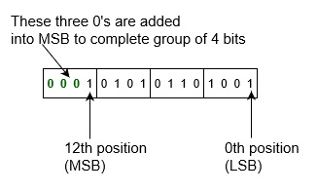
Binary to Hexadecimal number system
Example-1 − Convert binary number 1010101101001 into hexadecimal number.
Binary to hexadecimal is,
= (1010101101001)₂
= (1 0101 0110 1001)₂
= (0001 0101 0110 1001)₂
= (1 5 6 9)₁₆
= (1569)₁₆

Slide 29
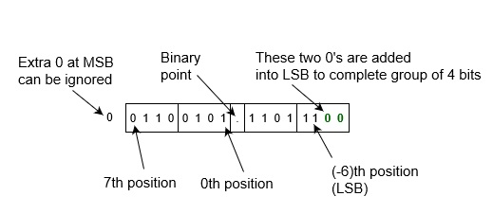
Binary to Hexadecimal number system
Example-2 − Convert binary number 001100101.110111 into hexadecimal number.
Binary to hexadecimal is,
= (001100101.110111)₂
= (0 0110 0101 . 1101 1100)₂
= (0110 0101 . 1101 1100)₂
= (6 5 . D C)₁₆
= (65.DC)₁₆

Slide 30
Convert Octal to Binary Using Table
Octal Number | Equivalent Binary Number
0 | 000
1 | 001
2 | 010
3 | 011
4 | 100
5 | 101
6 | 110
7 | 111

Slide 31
Convert Octal to Binary Using Table
Example: Convert 12₈ into a binary number.
Solution:
Given, 12₈ is the octal number.
Now with the help of the table, we can write;
12₈ = (001 010)₂
Example-2 − Convert octal number 352.563 into binary number.
According to above algorithm, equivalent binary number will be,
= (352.563)₈
= (011 101 010 . 101 110 011)₂
= (011101010.101110011)₂

Slide 32
octal to decimal conversion
The digits of given octal number starting from right most digit and keep a variable dec_value.
At the time of extracting digits from the octal number, multiply the digit with the proper base (Power of 8) and add it to the variable dec_value.
At the end, the variable dec_value will store the required decimal number.
For Example: If the octal number is 67. dec_value = 6*(8^1) + 7*(8^0)
= 55

Slide 33
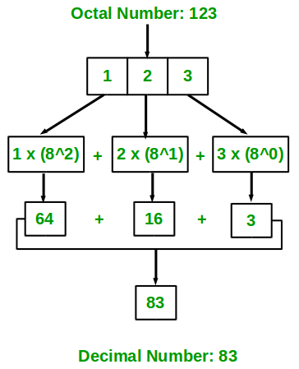
octal to decimal conversion
EXAMPLE-2:

Slide 34
Hexadecimal to Decimal
Example:1
9 = 9 * (16 ^ 0) = 9
C = 12 * (16 ^ 1) = 192
Then, we add the results.
=192 + 9
= 201₁₀ decimal
Example:2
The hex number A3C2.
2 x (16⁰) = 2 x 1 = 2
C x (16¹) = 12 x 16 = 192
3 x (16²) = 3 x (16 x 16) = 3 x 256 = 768
A x (16³) = 10 x (16 x 16 x 16) = 10 x 4096 = 40960
Add the results together:
2 + 192 + 768 + 40960 = 41922
So the decimal equivalent of A3C2 is 41922.

Slide 35
Hexadecimal to Binary Conversion
Step 1:
Write down the hex number. If there are any, change the hex values represented by letters to their decimal equivalents.
Step 2:
Each hex digit represents four binary digits and therefore is equal to a power of 2. The rightmost digit equals to 2⁰ (1), the next one equals to 2¹ (2), the next one equals to 2² (4) and the leftmost one equals to 2³ (8). Write these numbers (8, 4, 2 and 1) below the hex values.
Step 3:
Determine which powers of two (8, 4, 2 or 1) sum up to your hex digits. For example, if one of your hex values is 10, this means 8 and 2 sum up to 10 (4 and 1 are not used). If your hex number is 2, only 2 is used; 8, 4 and 1 are not.

Slide 36
Hexadecimal to Binary Conversion
Step 4:
Write down 1 below those 8, 4, 2 and 1’s that are used. Write down 0 below those that are not used.
Step 5:
Read the 1’s and 0’s from left to right to get the binary equivalent of the given hex number.
Let's apply these steps to the hex number (4FA)₁₆
4 F A
4 15 10

Slide 37
Hexadecimal to Binary Conversion
Step 2:
4 F A
4 15 10
8421 8421 8421
0100 1111 1010
Step 3:
(4FA)₁₆ = (10011111010)₂
Example 2:
(2C1)₁₆ = (1011000001)₂
2 C 1
2 12 1
8421 8421 8421
0010 1100 0001

Slide 38
Hexadecimal To Octal
Method to Convert Hex to Octal
For each given hexadecimal number digit, write the equivalent binary number. If any of the binary equivalents are less than 4 digits, add 0’s to the left side.
Combine and make the groups of binary digits from right to left, each containing 3 digits. Add 0’s to the left if there are less than 3 digits in the last group.
Find the octal equivalent of each binary group.

Slide 39
Hexadecimal To Octal
Example:
Convert 1BC₁₆ into an octal number.
Solution:
Given, 1BC₁₆ is a hexadecimal number.
1 → 0001,
B → 1011,
C →1100
Now group them from right to left, each having 3 digits.
000, 110, 111, 100
000→0,
110 →6,
111→7,
100→4
Hence, 1BC₁₆ = 674₈

Slide 40
Basic Gates Gates
The basic digital electronic circuit that has one or more inputs and single output is known as Logic gate.
Hence, the Logic gates are the building blocks of any digital system. We can classify these Logic gates into the following two categories.
Basic gates
Universal gates
Basic gates are
AND
OR
NOT gates.

Slide 41
Basic Gates Basic Gates
AND gate
An AND gate is a digital circuit that has two or more inputs and produces an output, which is the logical AND of all those inputs.
It is optional to represent the Logical AND with the symbol ‘.’.
The following table shows the truth table of 2-input AND gate.
A | B | Y = A.B
0 | 0 | 0
0 | 1 | 0
1 | 0 | 0
1 | 1 | 1

Slide 42
Basic Gates Basic Gates
AND gate
Here A, B are the inputs and Y is the output of two input AND gate.
If both inputs are ‘1’, then only the output, Y is ‘1’. For remaining combinations of inputs, the output, Y is ‘0’.
The following figure shows the symbol of an AND gate, which is having two inputs A, B and one output, Y.

Slide 43
Basic Gates Basic Gates
OR gate
An OR gate is a digital circuit that has two or more inputs and produces an output, which is the logical OR of all those inputs.
This logical OR is represented with the symbol ‘+’.
The following table shows the truth table of 2-input OR gate.
A | B | Y = A + B
0 | 0 | 0
0 | 1 | 1
1 | 0 | 1
1 | 1 | 1

Slide 44
Basic Gates Basic Gates
Here A, B are the inputs and Y is the output of two input OR gate.
If both inputs are ‘0’, then only the output, Y is ‘0’. For remaining combinations of inputs, the output, Y is ‘1’.
The following figure shows the symbol of an OR gate, which is having two inputs A, B and one output, Y.

Slide 45
Basic Gates Basic Gates
NOT gate
A NOT gate is a digital circuit that has single input and single output.
The output of NOT gate is the logical inversion of input. Hence, the NOT gate is also called as inverter.
The following table shows the truth table of NOT gate.
A | Y = A’
0 | 1
1 | 0

Slide 46
Basic Gates Basic Gates
Here A and Y are the input and output of NOT gate respectively.
If the input, A is ‘0’, then the output, Y is ‘1’. Similarly, if the input, A is ‘1’, then the output, Y is ‘0’.
The following figure shows the symbol of NOT gate, which is having one input, A and one output, Y.

Slide 47
Basic Gates Universal Gates
NAND & NOR gates are called as universal gates.
Because we can implement any Boolean function, which is in sum of products form by using NAND gates alone.
Similarly, we can implement any Boolean function, which is in product of sums form by using NOR gates alone.
NAND gate
NAND gate is a digital circuit that has two or more inputs and produces an output, which is the inversion of logical AND of all those inputs.
The following table shows the truth table of 2-input NAND gate.

Slide 48
Universal Gates
Here A, B are the inputs and Y is the output of two input NAND gate. When both inputs are ‘1’, the output, Y is ‘0’.
If at least one of the input is zero, then the output, Y is ‘1’. This is just opposite to that of two input AND gate operation.
The following image shows the symbol of NAND gate, which is having two inputs A, B and one output, Y.
A | B | Y = (A.B)’
0 | 0 | 1
0 | 1 | 1
1 | 0 | 1
1 | 1 | 0

Slide 49
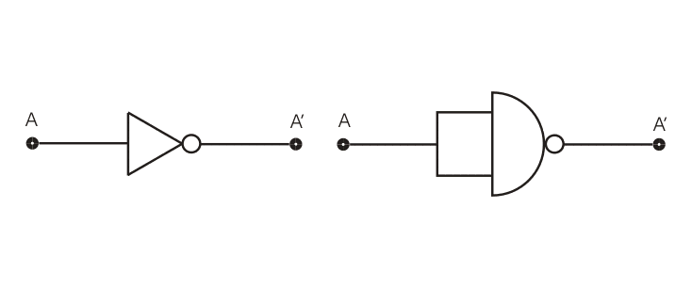
Basic Gates Universal Gates
NAND gate operation is same as that of AND gate followed by an inverter.
Now we will see how this gate can be used to make other gates.

Slide 50
Basic Gates Universal Gates
Now we will see the design of an AND gate from NAND gates.
NOR Gate
Logic diagram

Slide 51
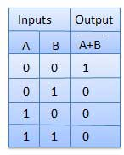
Basic Gates Universal Gates
Truth Table

Slide 52
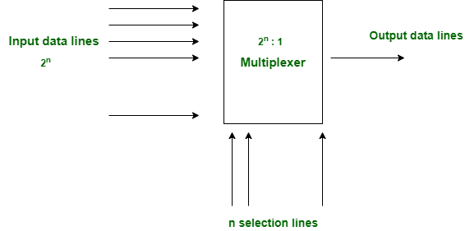
Multiplexer and Demultiplexer
1. Multiplexer : Multiplexer is a data selector which takes several inputs and gives a single output.In multiplexer we have 2^{n} input lines and 1 output lines where n is the number of selection lines.

Slide 53
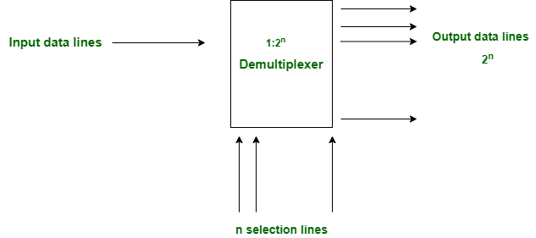
Multiplexer and Demultiplexer
2. Demultiplexer : Demultiplexer is a data distributor which takes a single input and gives several outputs.In demultiplexer we have 1 input and 2^{n} output lines where n is the selection line.

Slide 54
Multiplexer
Understanding 4-to-1 Multiplexer:
The 4-to-1 multiplexer has 4 input bit, 2 control bits, and 1 output bit. The four input bits are D0,D1,D2 and D3. only one of this is transmitted to the output y.
The output depends on the value of AB which is the control input. The control input determines which of the input data bit is transmitted to the output.
For instance, as shown in fig. when AB = 00, the upper AND gate is enabled while all other AND gates are disabled. Therefore, data bit D0 is transmitted to the output, giving Y = Do.

Slide 55
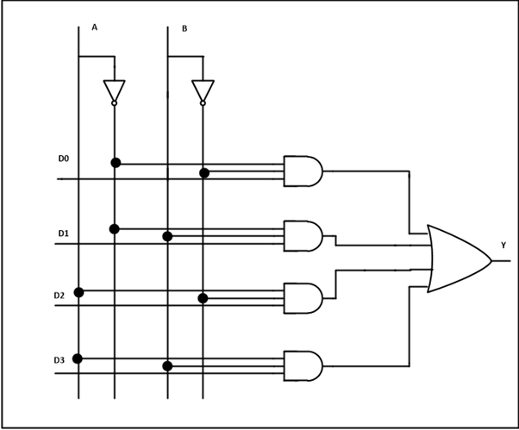
4-to-1 Multiplexer

Slide 56
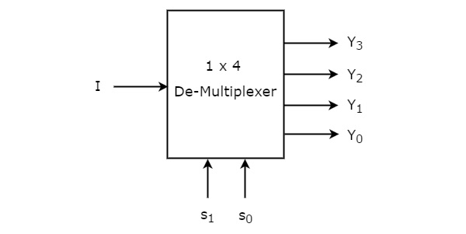
4-to-1 DE-Multiplexer
1x4 De-Multiplexer
1x4 De-Multiplexer has one input I, two selection lines, s₁ & s₀ and four outputs Y₃, Y₂, Y₁ &Y₀.
The block diagram of 1x4 De-Multiplexer is shown in the following figure.

Slide 57
4-to-1 DEMultiplexer
The single input ‘I’ will be connected to one of the four outputs, Y₃ to Y₀ based on the values of selection lines s₁ & s0.
The Truth table of 1x4 De-Multiplexer is shown below.
Selection Inputs |  | Outputs
S₁ | S₀ | Y₃ | Y₂ | Y₁ | Y₀
0 | 0 | 0 | 0 | 0 | I
0 | 1 | 0 | 0 | I | 0
1 | 0 | 0 | I | 0 | 0
1 | 1 | I | 0 | 0 | 0

Slide 58
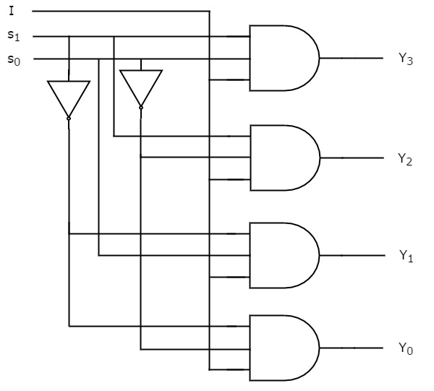
4-to-1 DEMultiplexer
From the above Truth table, we can directly write the Boolean functions for each output as
Y3=s1s0I
Y2=s1s0′I
Y1=s1′s0I
Y0=s1′s0′I

